Slide 1
Setup WiFi port with the BrailleApp
Braille printing made easy
www.indexbraille.com

Slide 2
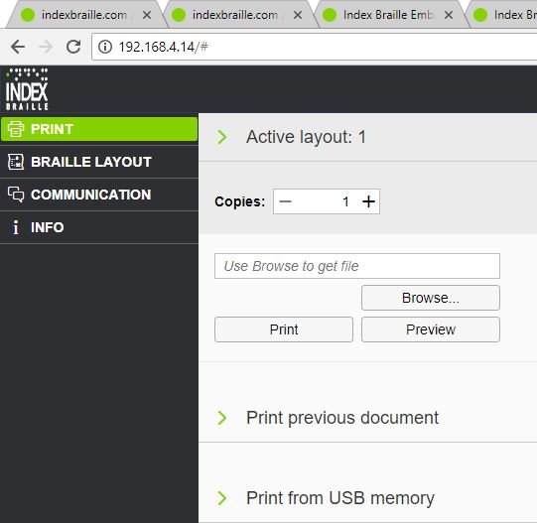
Start the BrailleApp
Make sure the V5 printer is connected to a LAN with DHCP support
Get the wired IP address of your V5 printer by.
HELP+10 in voice feedback
HELP+1 print network information page
Open your favourite browser
Type the IP address in the browser
The BrailleApp home page is now presented

Slide 3
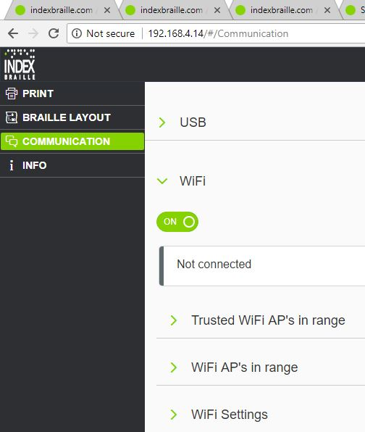
BrailleApp WiFi menu
Go to:
Communication
Wi-Fi
On/off
Connected WiFi network
Trusted WiFi AP’s in range
WiFi AP’s in range
WiFi Settings

Slide 4
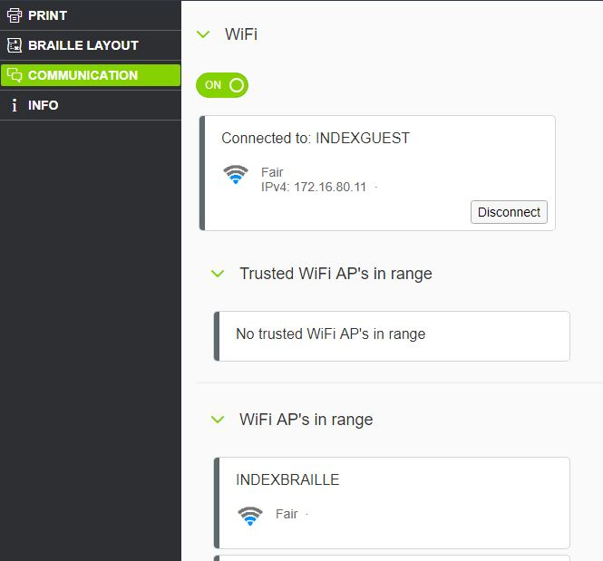
WiFi setup with password
Turn on the WiFi
If the printer has not been connected to your network before, go to WiFi Ap’s in range
Open the WiFi AP’s in range
Select connect
Insert “password” + connect
Connected when the blue WiFi icon on the control panel is lighted
Get WiFi IP address by HELP+10 voice or HELP+1 text

Slide 5
Start the BrailleApp on WiFi network
Open your favourite browser
Type the WiFi IP address of your V5 in the browser
The BrailleApp home page is now presented

Slide 6
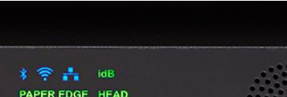
Disconnect network cord
Now when the WiFi network is established the wired network cord can be removed.
Remove the network cord
The wired internet icon is unlit, disconnected
The WiFi icon is lit, connected
Press HELP+10 to confirm the WiFi network address and SSID address.

Slide 7
Ready to use the V5 printer on WiFi
Your V5 printer is now ready to be used on your LAN.
All BrailleApp functions are presented after typing the WiFi IP address in the browser.
Create a TCP/IP printer port in Windows
Required when printing from an external braille editor, for example Duxbury
Required when printing with idB, right click on the file and select the TCP/IP printer port

