Slide 1
Handling of V5 layouts with the BrailleApp
Braille printing made easy
www.indexbraille.com

Slide 2
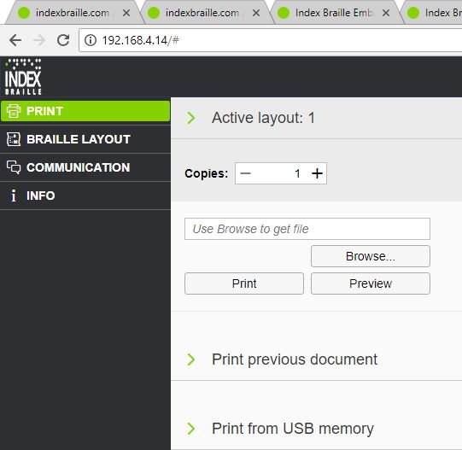
Start the BrailleApp
Make sure the V5 printer is connected to a LAN with DHCP support
Get the wired IP address of your V5 printer by.
HELP+10 in voice feedback
HELP+1 print network information page
Open your favourite browser
Type the IP address in the browser
The BrailleApp home page is now presented

Slide 3
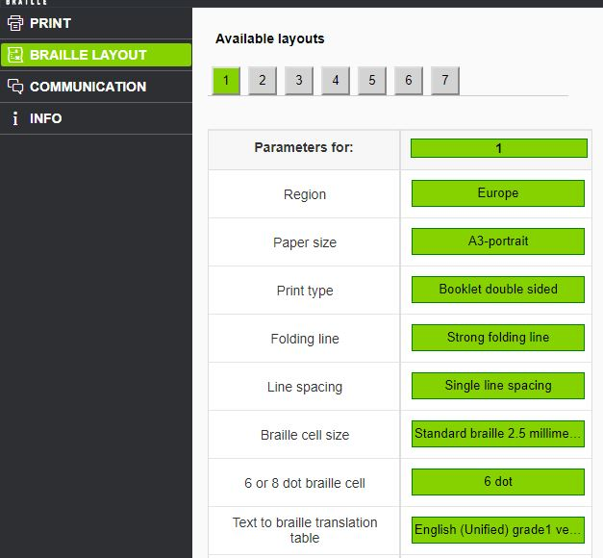
View braille layouts
Click on one of the layouts. Green is the active braille layout
Most important Active layout settings
Paper size
Text-to-braille translation language and grade
Lines per page
Characters per line
Margins
Page number

Slide 4
Set an other layout as active layout
Click on an other layout than the active (1- max 9)
The value of the selected layout will now be presented in the list
Press “set active layout”
Your new layout will be active and marked with green in the list.

Slide 5
Delete layout
Menu “Braille Layout”
Click on “Remove layout” and the corresponded layout is removed
It is not possible to remove an active layout

Slide 6
Add a layout
Menu “Braille Layout”
Click on “Add layout” and a new layout will be added.
The values of this new layout will be the identical with the original one
The number of the new layout will be the lowest available number of 1-9
Maximum number of layouts are 9.

Slide 7
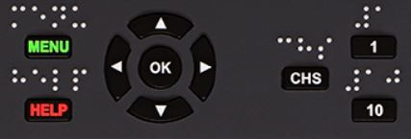
Edit a layout
The edit function is currently not implemented in the BrailleApp
Make the selected layout to an active layout
Make the editing of the layout from the control panel of the V5 printer
MENU/ Braille Layout/ Edit active layout/ Standard wizard
Run the layout wizard
Advanced wizard also includes; paper region, line spacing, Braille cell size, Legacy braille translation table, volume separation, braille volume number and multiple impacts.
The edited layout is always the active layout.

Slide 8
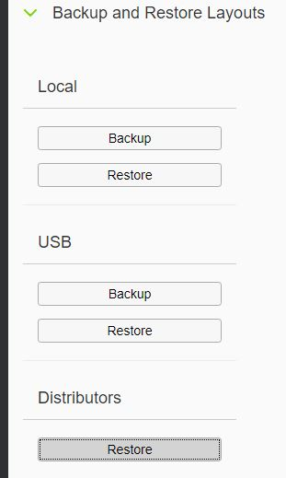
Backup layouts
Backup the complete list of layouts on a USB memory stick
or to the internal printer memory.
Backup and restore layouts
Local
Backup
Restore
USB
Backup
Restore
Restore distributor default layouts. These are available when
the local distributor layouts have been implemented in the
embosser Firmware.
Braille layout/ Restore
Select country and distributor

