Slide 1
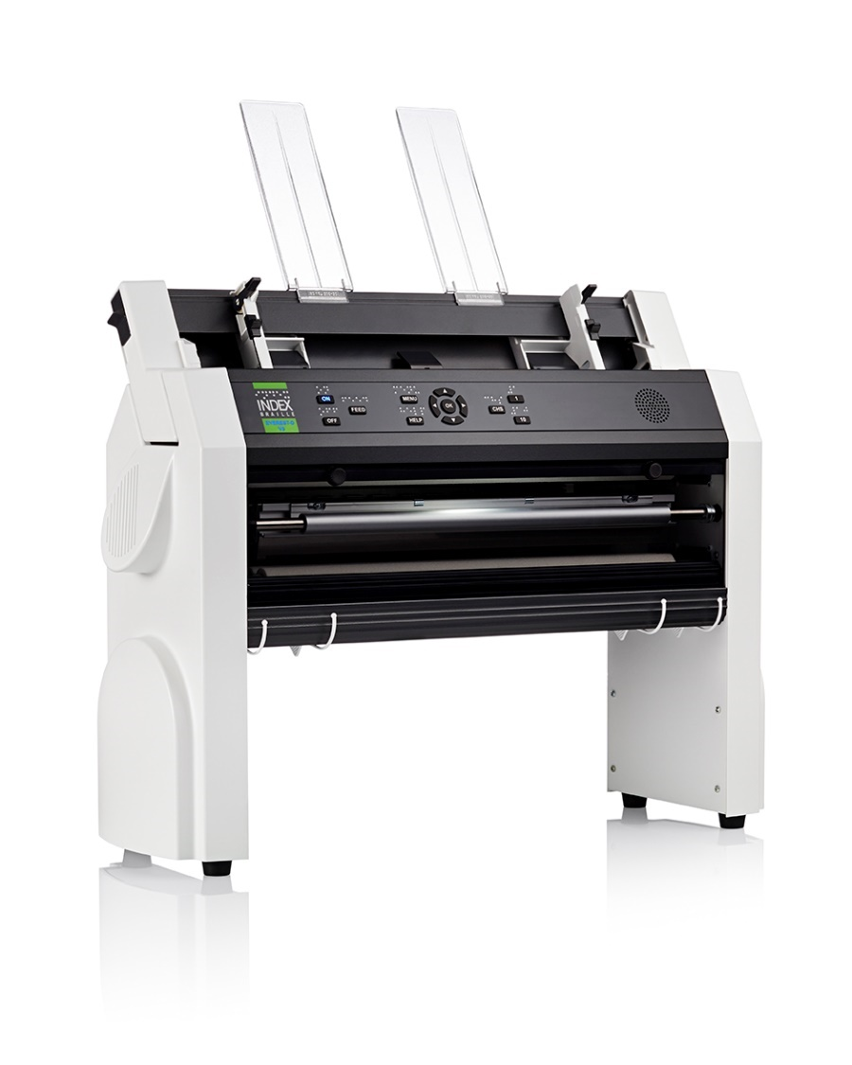
Everest-D V5 presentation
Braille printing made easy
www.indexbraille.com

Slide 2
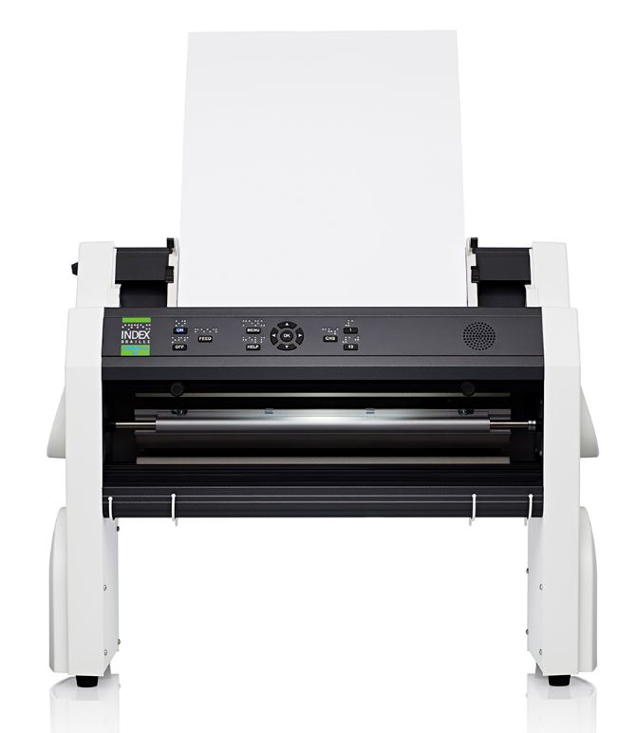
Most popular cut-sheet braille printer
High braille quality
50-pages sheet-feeder
Fast
Small and powerful
Competitive price
Braille and text labelled
control panel
The Braille translation is included,
no need for additional
braille editor

Slide 3
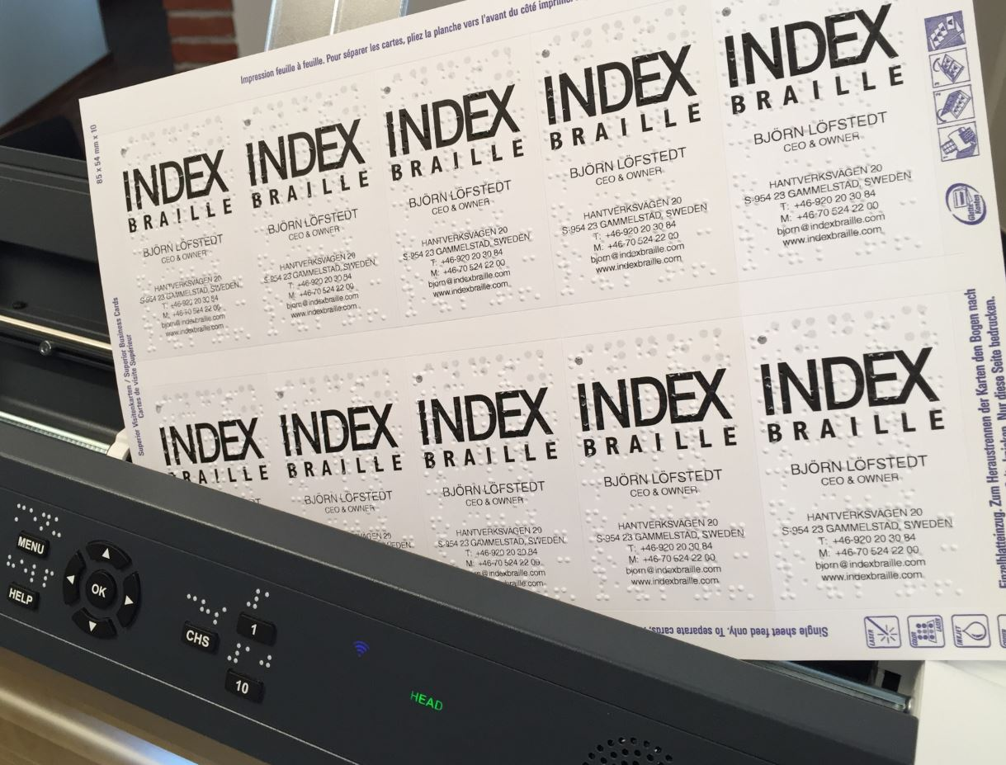
Everest-D the most flexible printer
Portrait and landscape printing
Booklet printing (recommended)
Print braille on top of text paper
Print business card, standard Avery
Print
Durable construction
Support user defined paper size

Slide 4
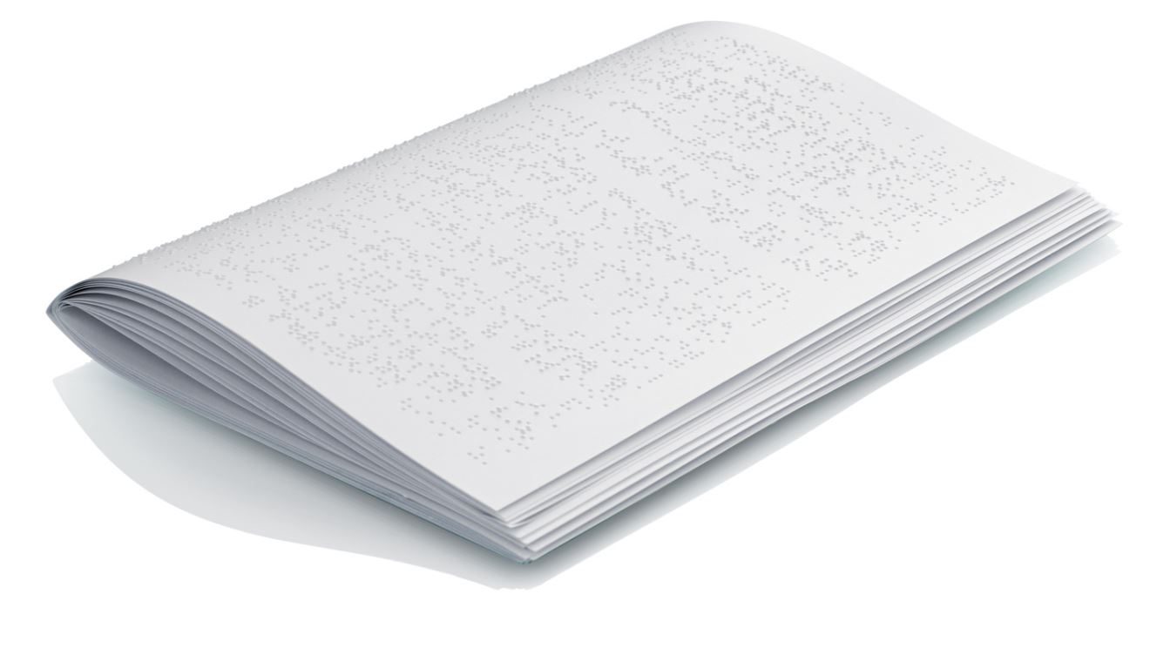
Booklet a recommended format
Booklet printing is typically made on A3 or 11,5x17 inch paper, it folds to A4 or letter format. Benefits with booklet:
The paper out works is reduced to staple and fold. No need for holing, wire binding etc.
The embossing speed is higher than on smaller A4/letter papers
The function of the sheet-feeder is even more stable with this wider paper.

Slide 5
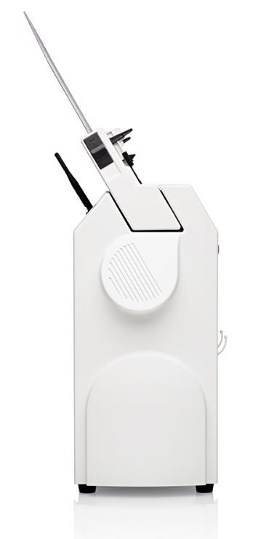
Everest-D stays for ever
Everest is the market leading sheet-fed braille
printer since the introduction of V1 in 1992.
Everest is 100% constructed by Index
Everest sheet-feeder production tools and
intellectual property is owned by Index
The sheet feeder is tuned for best function on
heavy braille paper
Durable construction tuned into perfection

Slide 6
High quality braille
Index braille is well known since decades for good braille quality. This is how we define high quality braille:
Round dot, following the surface of sphere
  With no holes
  With no cracks
Braille dot dimensions
  Height 0,5 mm
  Diameter of dot base 1,6 mm
  Diameter of the sphere 1,7 mm
Braille cell size
  Distance within the cell 2,5 mm
  Distance between the cells 3,5 mm
  Placed in a perfect grid

Slide 7
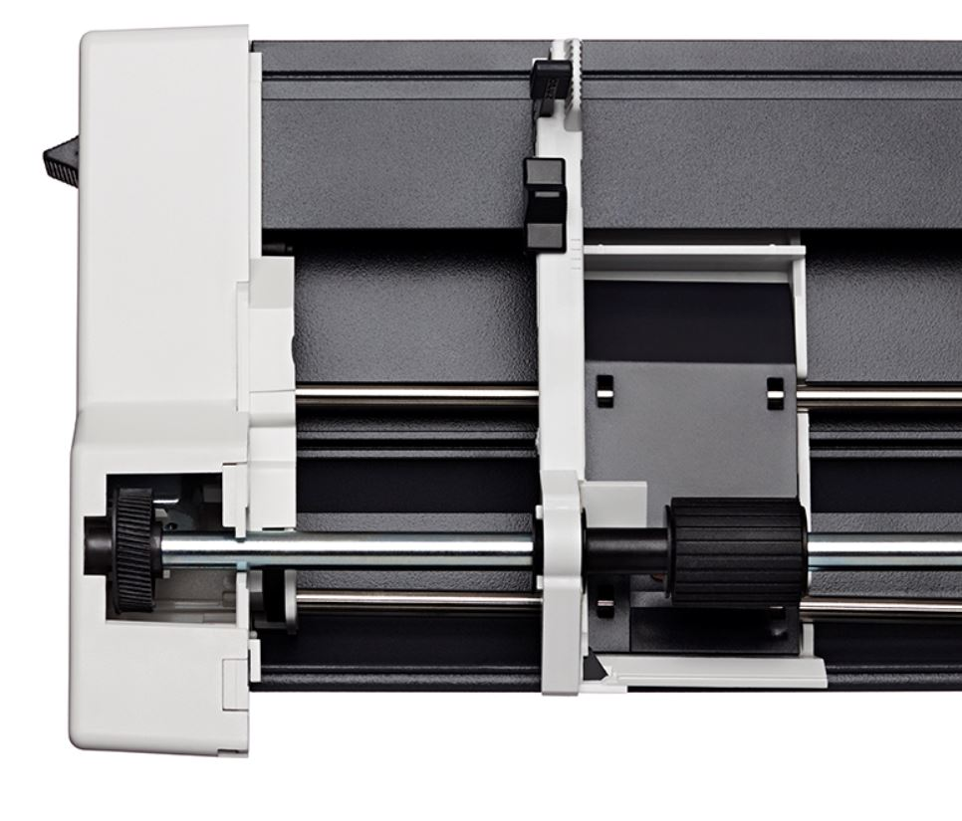
Useful cut-sheet feeder
Cut-sheet paper is available every ware
Cut-sheet paper is inexpensive
Paper width up to 297 mm
Paper length up to 600 mm
50 pages sheet-feeder the tools and
production rights are owned by
Index.

Slide 8
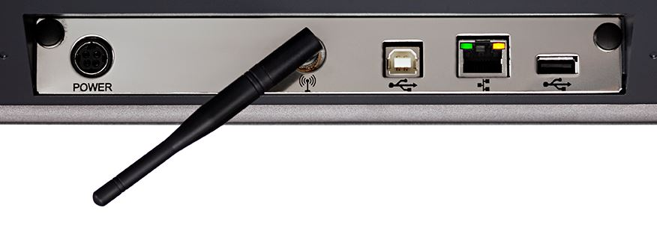
All connectors
Network
  Wired Network port
  WiFi
Bluetooth
Standard USB port
USB Host port
Braille printing from standard USB

Slide 9
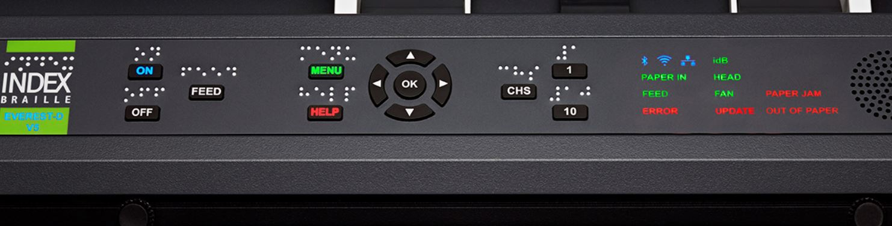
Modern user interface
Control panel
  Speech feedback in 19 languages
  Speaker embedded in control panel
  Labelled in braille and text
  LED lighted text and icon feedback

Slide 10
Useful features
No need for a separate braille editor with on the fly translation
Support all operation systems
Supports horizontal and booklet (vertical) printing
Index BrailleApp
USB Host port for printing from a USB memory
High resolution tactile graphics
Acapela speech guide the user
Liblouis text-to-braille translation is included
  More than 150 languages
  Literary (G1) and contracted (G2) braille

Slide 11
The idea of booklet printing
A an A3 paper, two double sided A4 pages are printed with a folding line between
The printer automatically organize the braille printout for binding without manual handling
The booklet braille production process
  Print
  Staple
  Fold

Slide 12
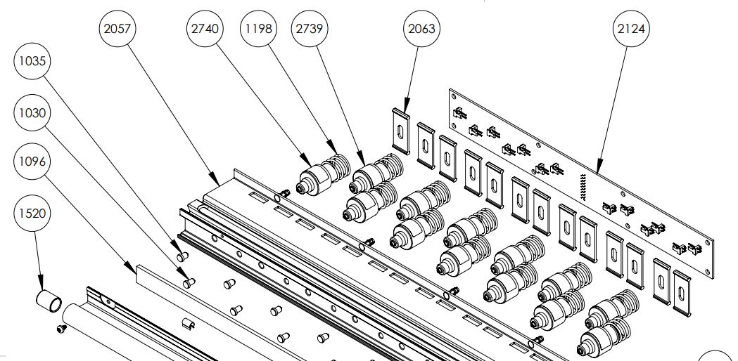
Built to last
Everest-D is 100% constructed by Index
The sheet-feeder tools and production rights are own by Index
The clean module design is the core for a competitive price with world leading quality.
Easy to maintain
  Replacement of modules is quick and
  require minimum training
  No mechanical adjustments
  Firmware upgrade is free,
  at www.indexbraille.com
Open information structure
  Spare parts web
  Exploded view document
  Knowledge base questions
  Spare parts available many years
  support@indexbraille.com to access support portal

Slide 13
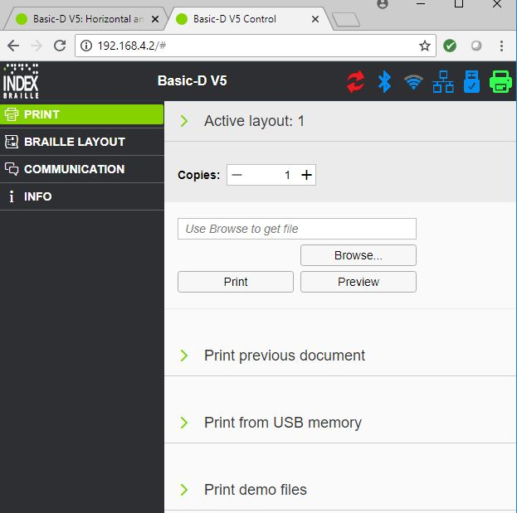
BrailleApp the future
The BrailleApp is the next generation of interface to
Index V5 printers.
Support all common operating systems
Print braille without using a traditional braille editor
  Print in literary (G1) or contracted (G2) braille
  Preview the braille file in text or as braille-dots
  Edit the translated braille file
  Brows for source file
    docx, doc and pdf
    From your computer
    From the USB memory inserted on the printer
Monitor and control printer icons
  Firmware upgrade
  Bluetooth
  Wi-Fi
  Wired network
  USB memory inserted on the printer
  Embosser status

Slide 14
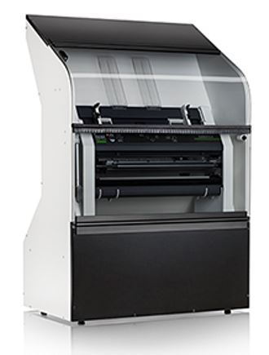
Acoustic Hood Everest
Noise level only 60 db(A)
Supports up to A3/11,5X17”
Holds 50 papers
Comes ready to use
Ventilation by embosser fan

Slide 15

Welcome to our world
Braille printing made easy
www.indexbraille.com

