Slide 1
BrailleApp Introduciton
Braille printing made easy
www.indexbraille.com

Slide 2
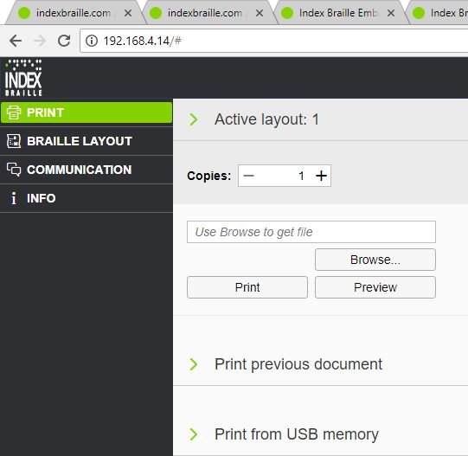
Start the BrailleApp
Get the IP address of your V5 printer
HELP+10 in voice feedback
HELP+1 print network information page
Open your favourite browser
Type the IP address in the browser
The BrailleApp home page is now presented

Slide 3
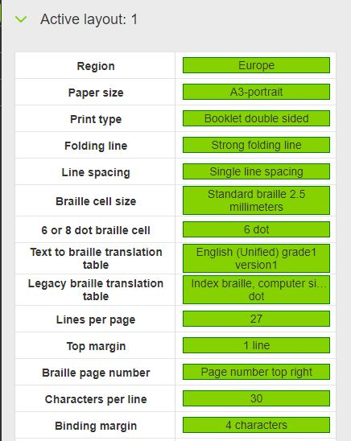
Active layout
Click on your “Active Layout no#”
The text-to-braille translation, formatting and page numbering will follow the setting of Active Layout in your printer
Most important Active layout settings
Paper size
Print type
Text-to-braille translation-language and grade
Lines per page
Characters per line
Margins
Page number

Slide 4
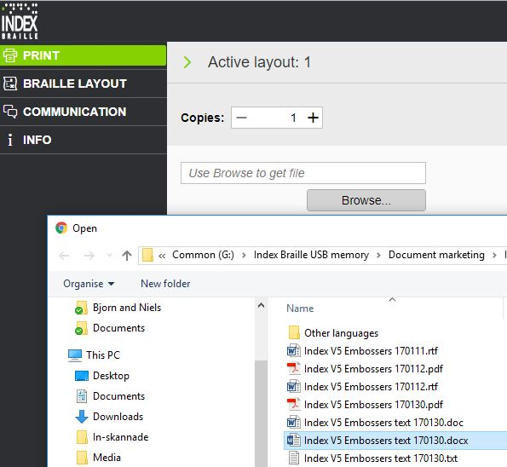
Browse for a file on you local computer
Browse to the file and select it
docx, doc, pdf are supported and may be pre-viewed and edit
Docx is recommended
Supported without pre-view
Brf (braille file)
Ibe (Index Braille Embosser)
Ipf (Index Print Format) BrailleApp format

Slide 5
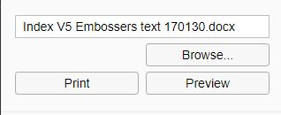
BrailleApp file selected
When a file is selected it is presented in the file window of the BrailleApp
Select function
Preview, edit, save and print
Print directly without presenting the braille text on your device

Slide 6
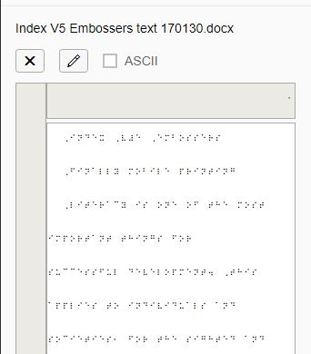
Preview
Translation and formatting will follow the settings of the active layout setting
Presentation in ASCII (MIT Code) or Braille
You-See-Is-What-You-Get, braille pages, formatting, margins, page number
View and edit
Braille mode (six key entry)
ASCII mode, normal keyboard MIT

Slide 7
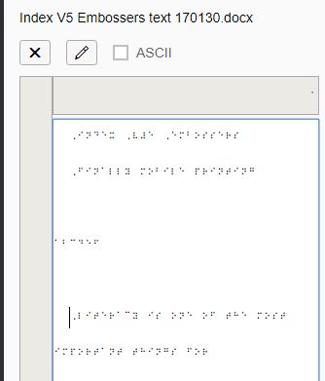
Edit Braille
Press the “pen” icon, the blue frame indicates “open for edit”
Use six-key-entry to edit the translated braille text
Test: insert “abcdef “ with empty lines before and after

Slide 8
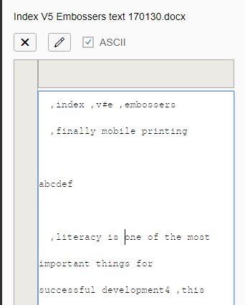
Edit Braille in ASCII
Mark the ASCII checkbox
The braille document is now presented as ASCII
The braille character is presented with corresponding MIT ASCII character.
Edit the text as usual, using mouse, arrows, backspace, delete and corresponding MIT characters

Slide 9
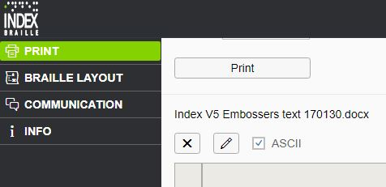
Print Braille document
Press “Print”
Print the document as presented in the preview window
Select number of copies
Select from page to page

Slide 10
Braille printing made easy
Your first Braille document with the BrailleApp in now printed.
The BrailleApp is available in all Index V5 printers.
New firmware releases is available free of charge and includes:
New BrailleApp functions
More Liblouise text-to-braille translation
Bug fixes

