Slide 1
Presentation Index BrailleApp Alpha version 2018-04-06

Slide 2
Index BrailleApp
Index BrailleApp is included in the latest Index V5 firmware and available when a V5 printer is connected to a LAN (Local Area Network) connection. This makes it possible to:
  Print standard files (doc, docx, pdf) in Braille (Grade 1, Grade 2, 150 languages)
  View the braille file with text or braille fonts
  Edit the braille file in braille (six-key-entry) or in text
  Monitor printer icons, printer status, USB memory stick, wired network, WiFi network and Bluetooth
  Setup WiFi network
  View and setup active layout of the V5 printer
  Available free of charge
  Unlimited number of users
  More to come…

Slide 3
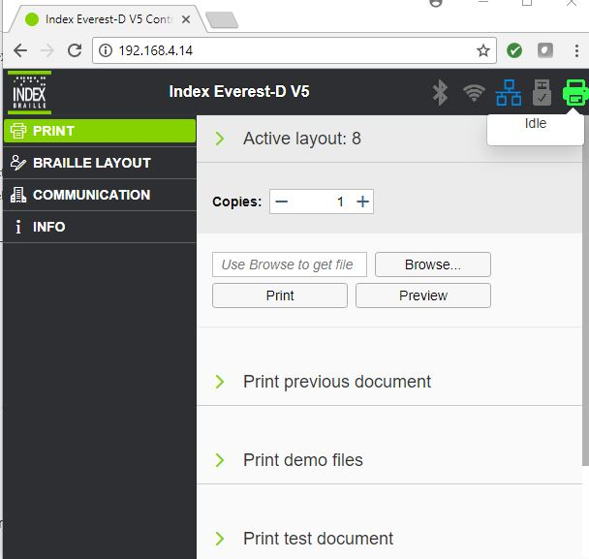
WebApp 1st page

Slide 4
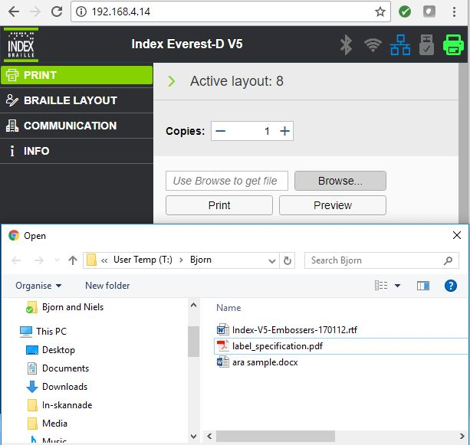
WebApp browse a file

Slide 5
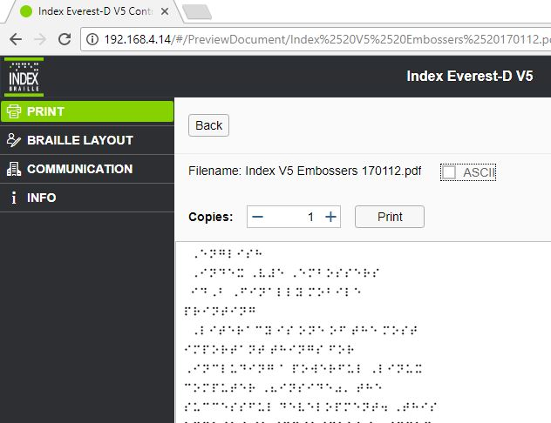
BrailleApp preview braille

Slide 6
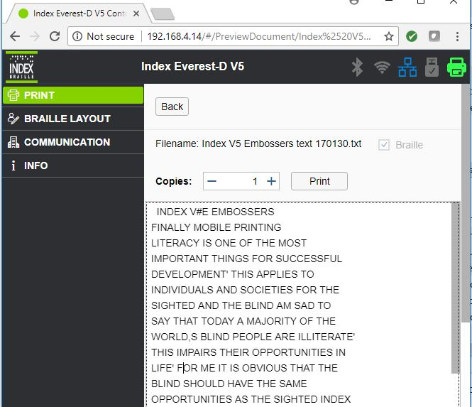
BrailleApp preview text

Slide 7
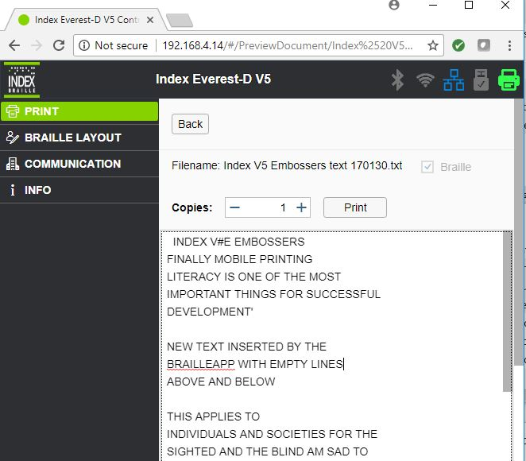
BrailleApp edit text

Slide 8
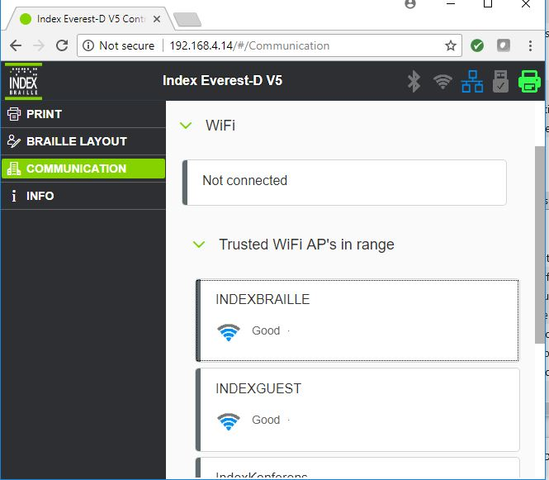
Web WiFi menu

Slide 9
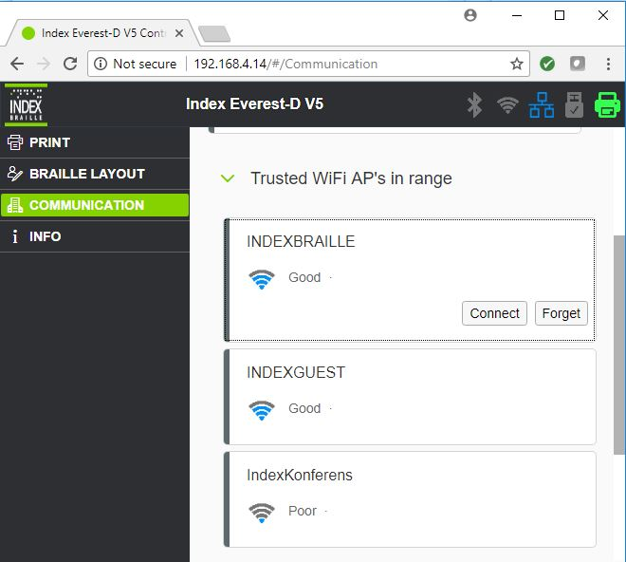
BrailleApp connect to WiFi

Slide 10
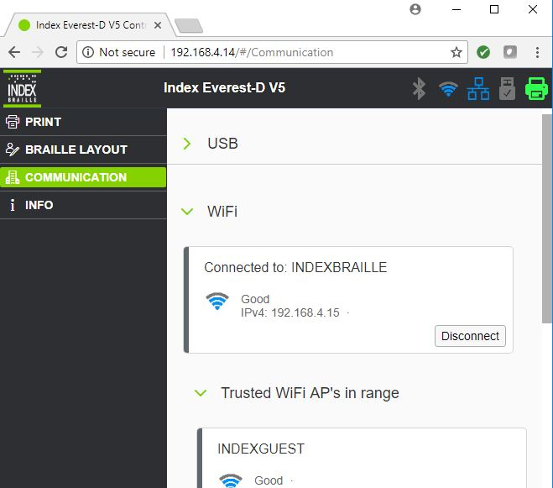
BrailleApp WiFi connect to network

Slide 11
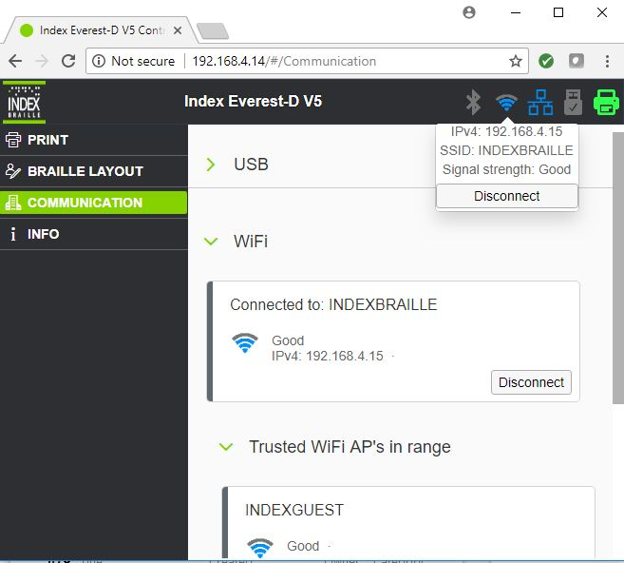
BrailleApp WiFi icon info

Slide 12
BrailleApp wired icon info

