Slide 1
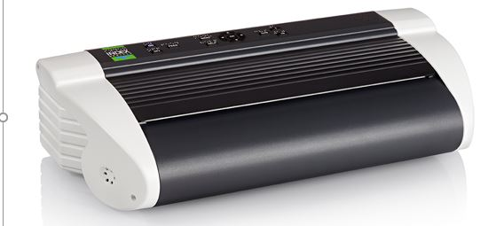
Basic-D V5 presentation
Braille printing made easy
www.indexbraille.com

Slide 2
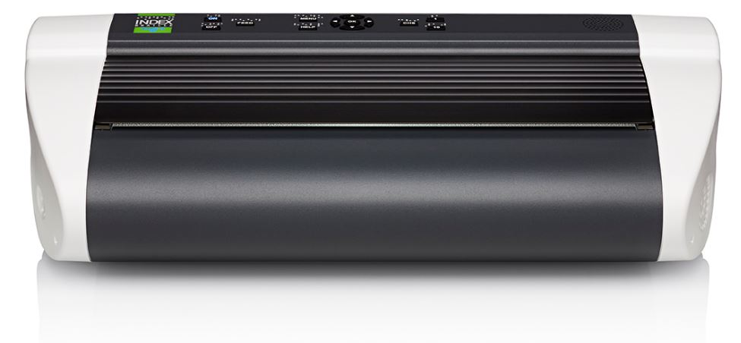
Most popular braille printer
High braille quality
Fast
Small and powerful
Competitive price
Braille and text labelled control panel
BrailleApp included, no need for additional braille editor

Slide 3
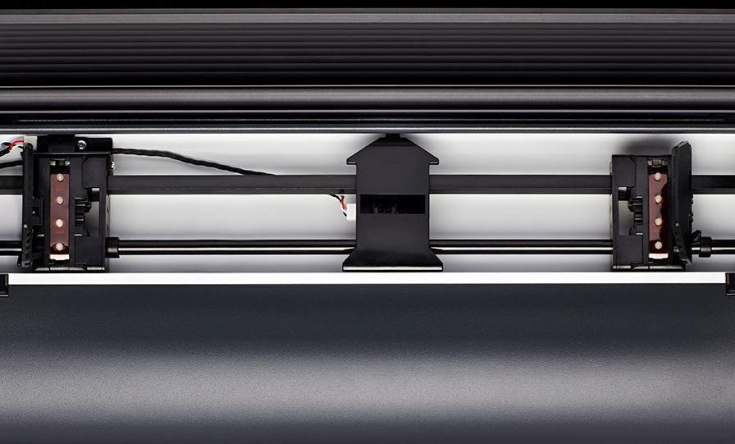
Easy paper loading
Tractor fed: the most reliable paper feeding method
The standard in many markets
Smart paper sensors
Automating paper loading
Paper jam detection
Support user defined paper size

Slide 4
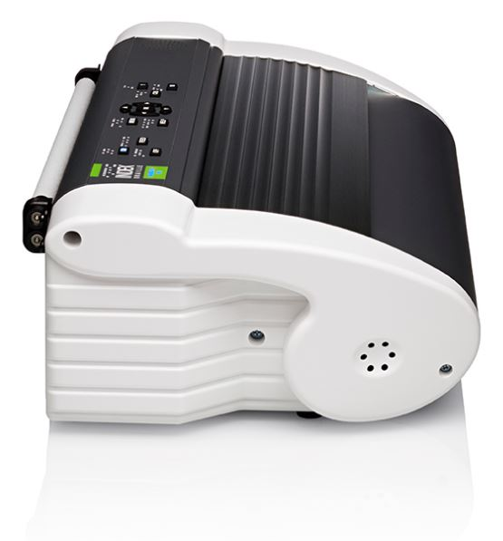
Small and powerful
7 kg
120 characters per second
Supports continuous printing

Slide 5
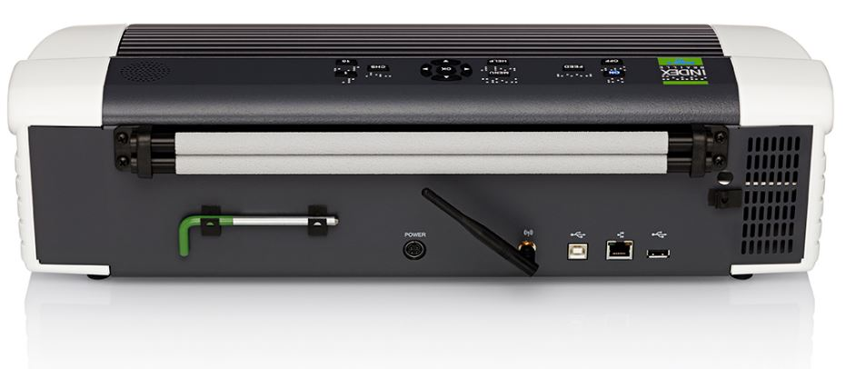
Connectors
Network
Wired connectivity port
Onboard WiFi
Bluetooth
Standard USB port
USB Host port Printing from standard USB Memory stick

Slide 6
Modern user interface
Control panel
Speech feedback in 19 languages
Speaker embedded in the control panel
Labelled in braille and text
LED lighted text and icon feedback

Slide 7
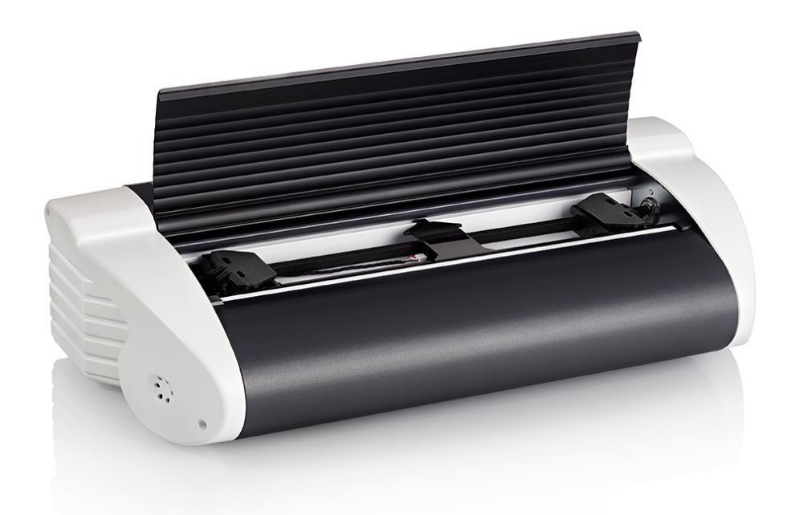
Useful features
No need for a separate braille editor
Supports all operating systems
Supports horizontal and vertical printing
Includes Index BrailleApp
USB Host port for printing from USB memory
Acapela speech guide the user
High resolution tactile graphics
Liblouis text-to-braille translation included
More than 150 languages
Literary (G1) and contacted (G2) Braille

Slide 8
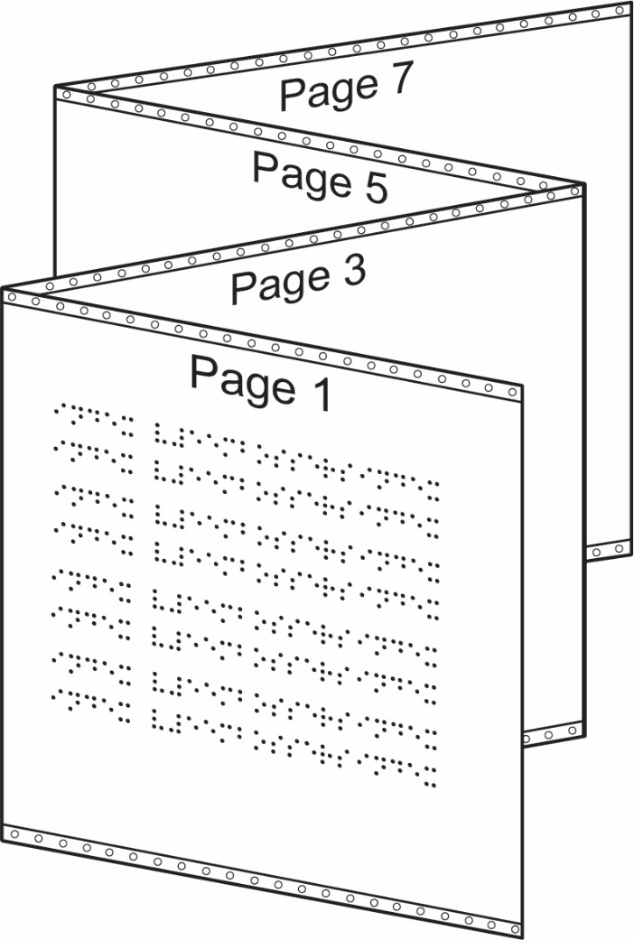
The idea of vertical printing
Reduces paper out work
No need to handle every paper individually
Increase the printing speed
Vertical printing supported by idB and the BrailleApp

Slide 9
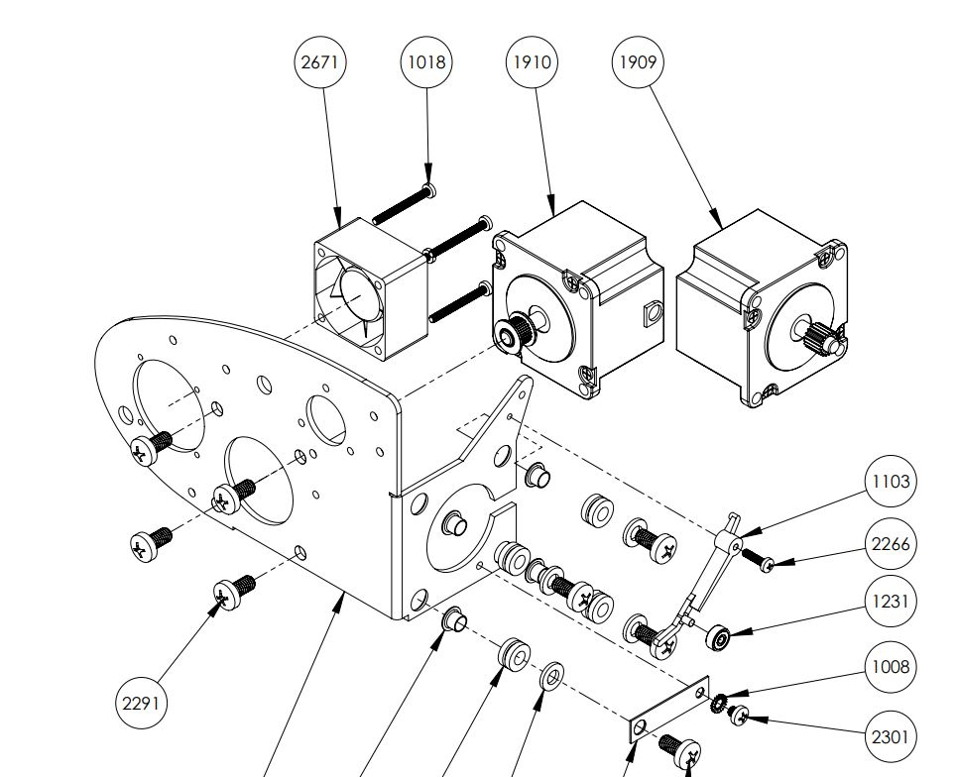
Built to last
100% constructed by Index Braille.
The clean module design is the core for a competitive price with world leading quality.
Easy to maintain
Replacement of modules is quick and require minimum training
No mechanical adjustments
Firmware upgrade is free, at www.indexbraille.com
Open information structure
Spare parts web shop
Exploded-view document
Knowledge base questions
Spare parts available many years
support@indexbraille.com to access the support portal

Slide 10
High quality braille
Index braille is well known since decades for good braille quality. This is how we define high quality braille:
Round dot, following the surface of sphere
With no holes
With no cracks
Braille dot dimensions
Height 0,5 mm
Diameter of dot base 1,6 mm
Diameter of the sphere 1,7 mm
Braille cell size
Distance within the cell 2,5 mm
Distance between the cells 3,5 mm
Placed in a perfect grid

Slide 11
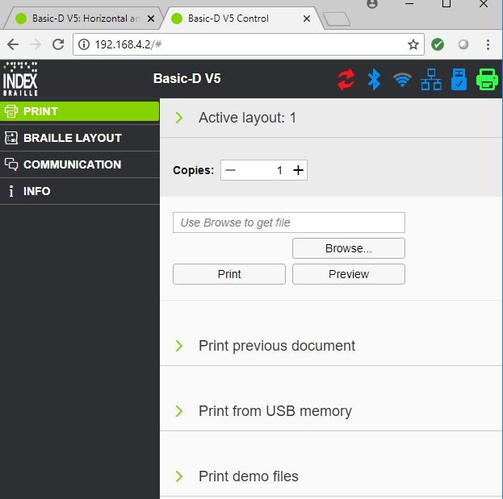
BrailleApp is the future
The BrailleApp is the next generation of interface to Index V5 printers.
Support all common operation systems
Print braille without using a traditional braille editor
Print in literary (G1) or contracted (G2) braille
Preview the braille file in text or as braille-dots
Edit the translated braille file
Brows for source file
docx, doc and pdf
From your computer
From the USB memory inserted on the printer
Monitor and control printer icons
Firmware upgrade
Bluetooth
Wi-Fi
Wired network
USB memory inserted on the printer
Embosser status

Slide 12
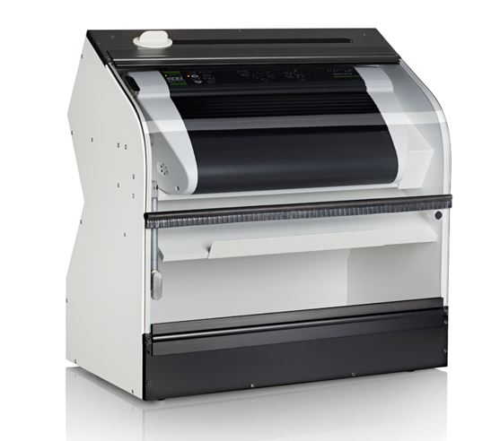
Acoustic Hood Basic
Braille printers are noisy. The Basic hood reduces the noise to a level acceptable in an office environment.
Noise level 63 db(A)
Unique paper cutter included
Delivered ready to be used
Ventilation using the embosser fan

Slide 13
Welcome to our world
Braille printing made easy
www.indexbraille.com

