Slide 1

Monitor printer status with the BrailleApp
Braille printing made easy
www.indexbraille.com

Slide 2
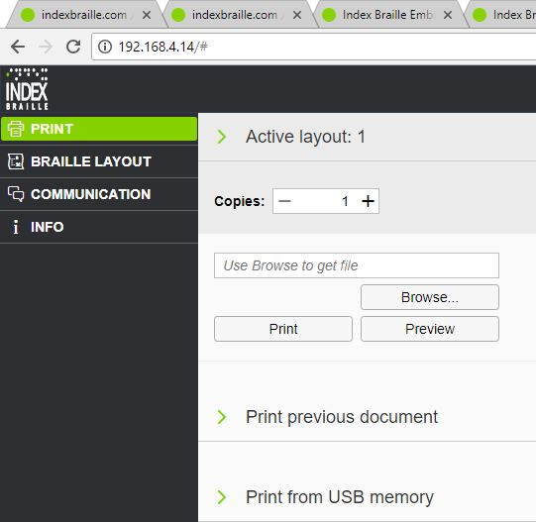
Start the BrailleApp
Make sure the V5 printer is connected
to a LAN with DHCP support
Get the wired IP address of your V5 printer
by
  HELP+10 for voice feedback
  HELP+1 for print feedback
Open your favourite browser
Type the IP address in the browser
The BrailleApp home page is now
presented

Slide 3
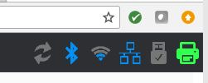
Monitor icons
The monitor icons are always
available in the BrailleApp and
include
  Frimware upgrade available
  Bluetooth on
  WiFi connected
  Wired network connected
  USB Memory connected to
  the V5 printer
  Embosser status

Slide 4
Firmware upgrade icon
The firmware upgrade icon,
to the far left lights red when a new
Firmware is available.
Upgrade firmware from the
control panel
  Menu/ user service/ firmware upgrade/
  firmware upgrade from internet
  The firmware upgrade process can
  take up to 15 minutes.
  DO NOT POWER DOWN THE PRINTER
  Firmware upgrade from the BraillApp
  will be available in Q3-2018

Slide 5
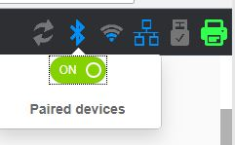
Bluetooth icon
Bluetooth icon functions
  Bluetooth on/off
  Pair Bluetooth devices

Slide 6
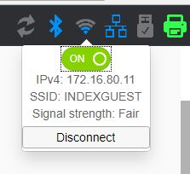
WiFi icon
WiFi incon functions
  WiFi on/off
  Lid when connected
  Light indicates signal strength
  Gives IP and SSID addresses
  Connect WiFi
    Insert password
    When WPS function is available on the
    router the “Start WiFi Protected Setup”
    key is displayed.
  Forget

Slide 7
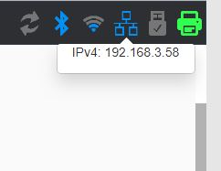
Wired network icon
Wired network icon functions
  Lid when wired network is connected
  Gives IP address

Slide 8
USB memory icon
USB memory icon functions
  Lid when a USB memory stick
  is connected.
  Safely remove USB memory stick

Slide 9

Printer icon
Printer icon functions
  Green = idle
  Yellow = printing
  Red = error
    For more information about the
    status, click on the printer icon

Slide 10
Monitor in BrailleApp
In addition to replacing the braille editor,
Index BrailleApp gives you a tool to
monitor the V5 printers
Enables remote monitoring of V5 printers

