Slide 1
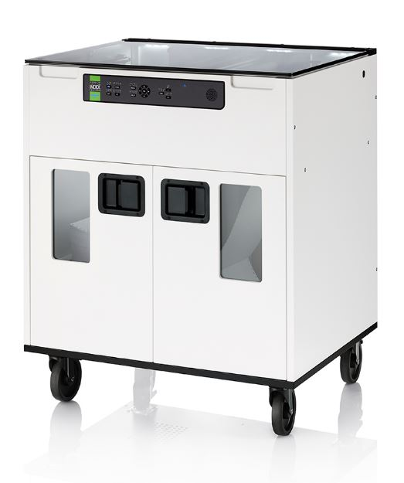
FanFold-D V5 presentation
Braille printing made easy
www.indexbraille.com

Slide 2
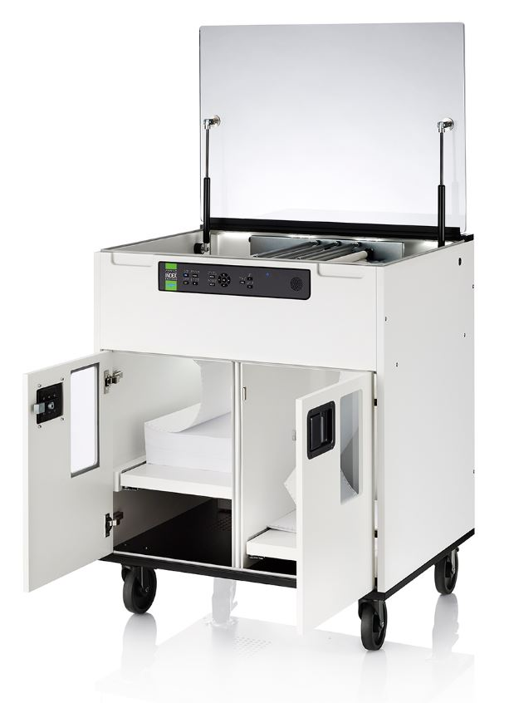
The idea of FanFold-D
Triple the printing speed of current embossers by using 3 embossing heads
Competitive price by
  Re-use Basic/Everest modules
  Re-use of well established modules to increases
  quality
  Re-use the module design of BrailleBox V5
  Benefit from higher volume of component
Low noise level by the closed construction and
muffled ventilation
Easy paper in and out areas
Glass and light are design objects
Dark active surfaces and light covers
Possible to mix braille and tactile graphic within the
same document.

Slide 3
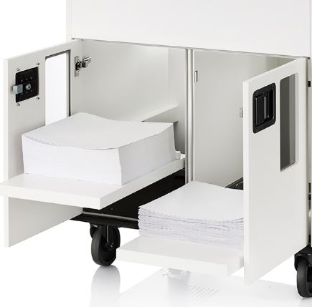
Tractor-fed paper a global standard
Since the introduction in 2016 FanFold-D has become an important high-speed embosser model on the global market
High braille quality
FanFold-D is constructed for continuous
braille production
Paper in area holds one 1000 pages
Braille out area hold up to 1000 pages
Clean construction gives easy maintaining
Braille and text labelled
control panel

Slide 4
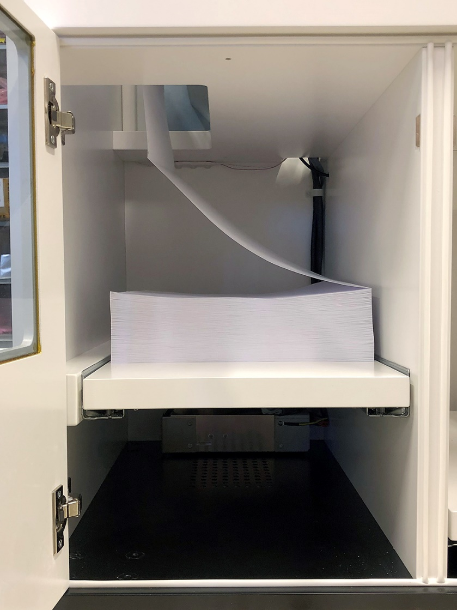
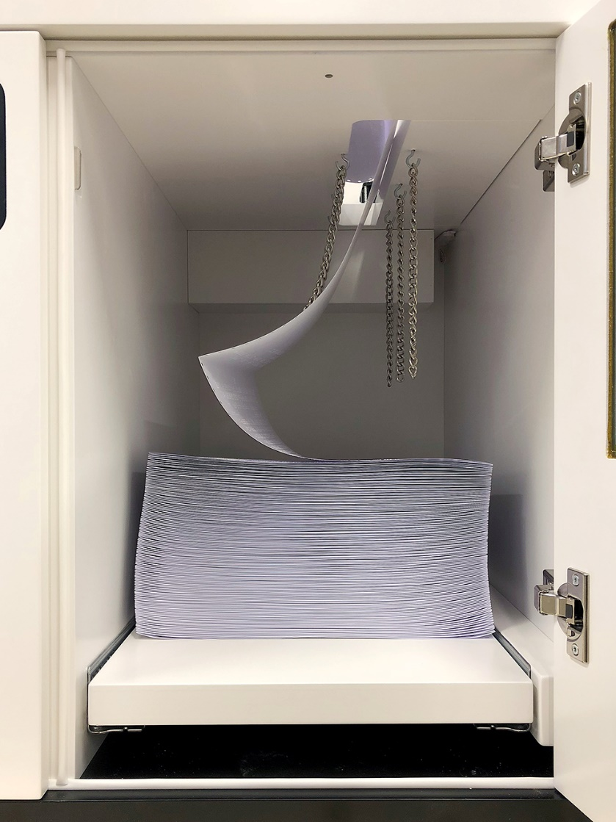
Easy paper access
Paper in
Paper out

Slide 5
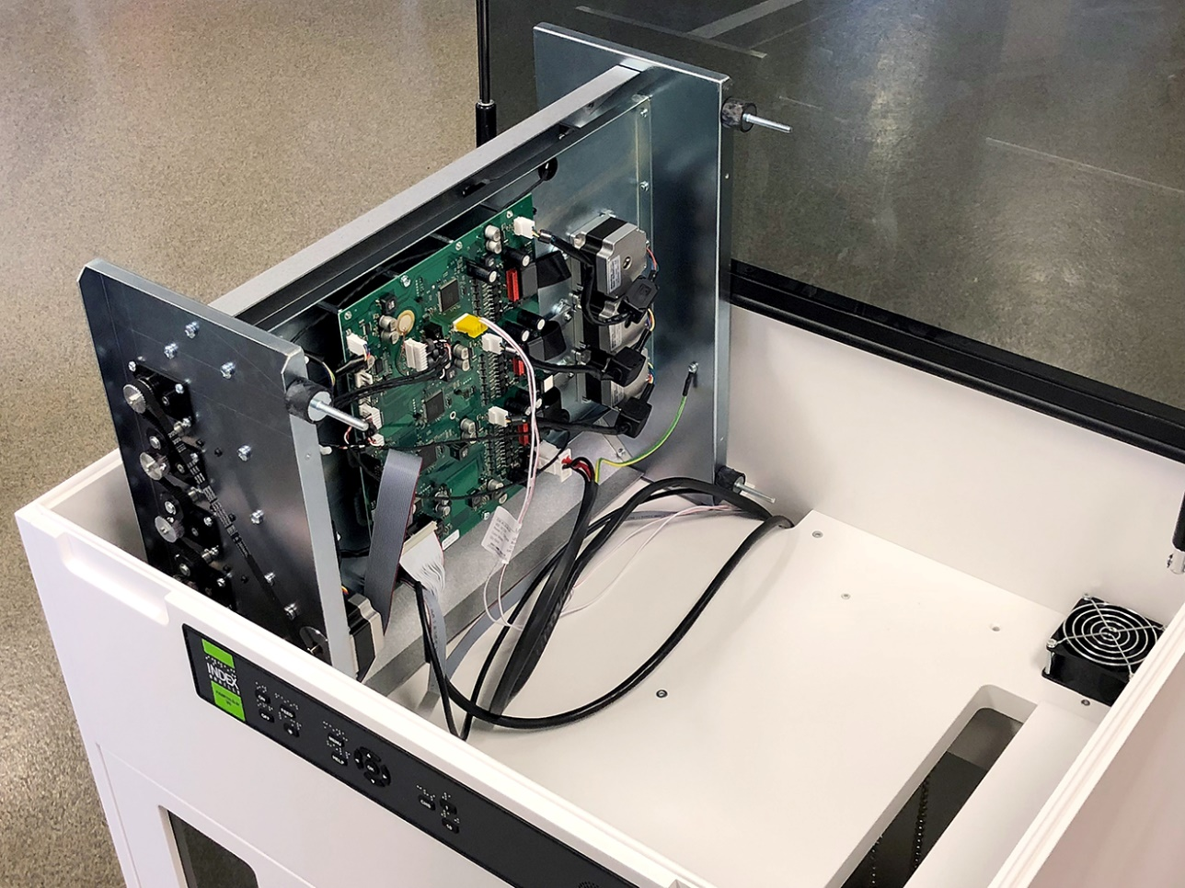
Maintaining made easy
Open the glass to access:
  The embossing module, tilted for service
  Paper loading
  The paper movement area
Left door is paper in
  Holds one box of paper
  Gliding shelf to simplify paper loading
Right door is braille out area
  The folding of the paper is guided
  Gliding shelf to simplify braille output

Slide 6
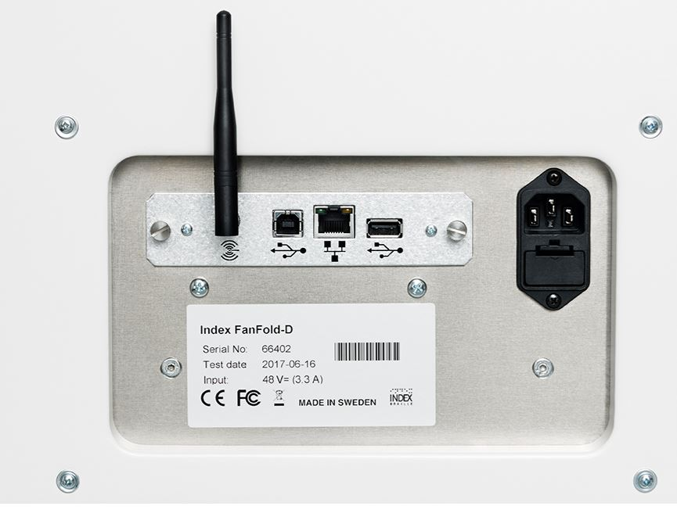
All connectors
Network
  Wired network port
  WiFi
Bluetooth
Standard USB port
USB Host port
Braille printing from
standard USB

Slide 7
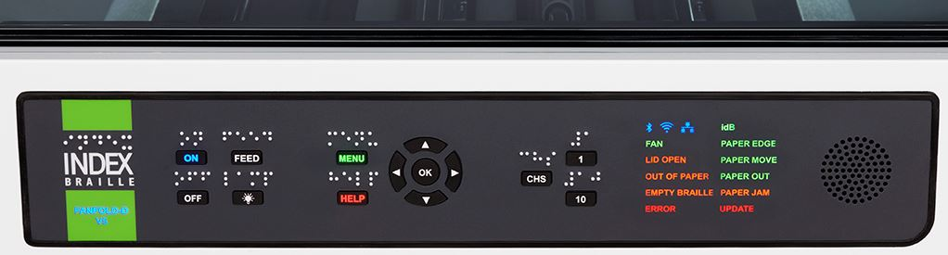
Modern user interface
Control panel
  Speech feedback in 19 languages
  Speaker embedded in control panel
  Labelled in braille and text
  LED lighted text and icon feedback

Slide 8
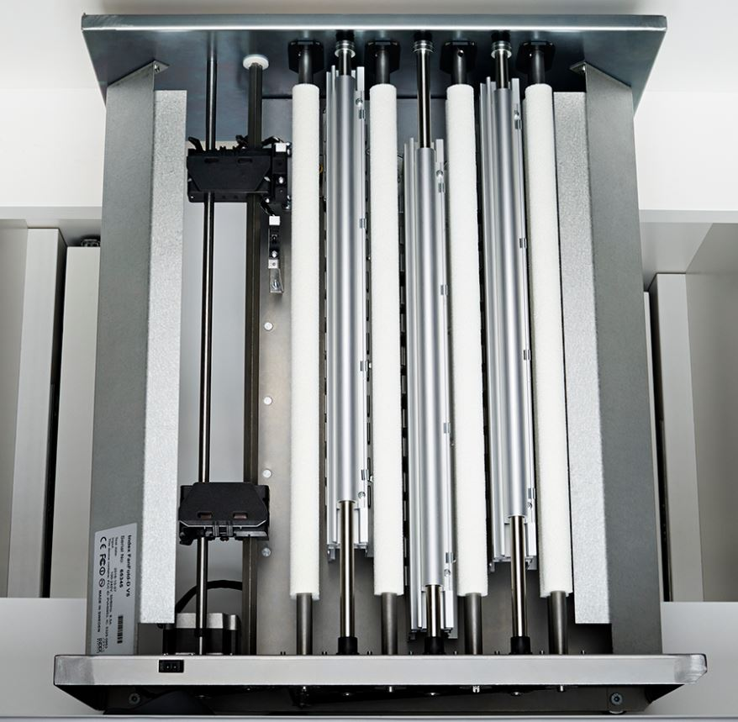
Useful features
No need for a separate braille editor
Support all operation systems
Supports booklet (vertical) printing
Index BrailleApp
USB Host port for printing from a USB memory
High resolution tactile graphics
Acapela speech guide the user
Remote support via Internet
Liblouis text-to-braille translation is included
  More than 150 languages
  Literary (G1) and contracted (G2) braille

Slide 9
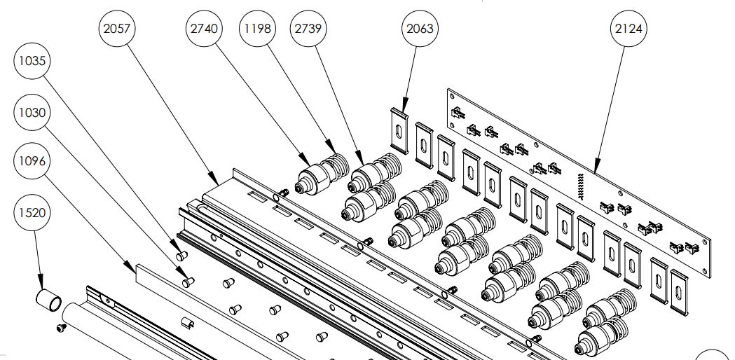
Build to last
FanFold-D is 100% constructed by Index
The clean module design is the core for a competitive price with world leading quality.
Easy to maintain
  Replacement of modules is quick and
  require minimum training
  No mechanical adjustments
  Firmware upgrade is free,
  at www.indexbraille.com
Open information structure
  Spare parts web
  Exploded view document
  Knowledge base questions
  Spare parts available many years
  support@indexbraille.com to access support portal

Slide 10
High quality braille
Index braille is well known since decades for good braille quality. This is how we define high quality braille:
Round dot, following the surface of sphere
  With no holes
  With no cracks
Braille dot dimensions
  Height 0,5 mm
  Diameter of dot base 1,6 mm
  Diameter of the sphere 1,7 mm
Braille cell size
  Distance within the cell 2,5 mm
  Distance between the cells 3,5 mm
  Placed in a perfect grid
  (Picture of a perfect dot, braille cell)

Slide 11
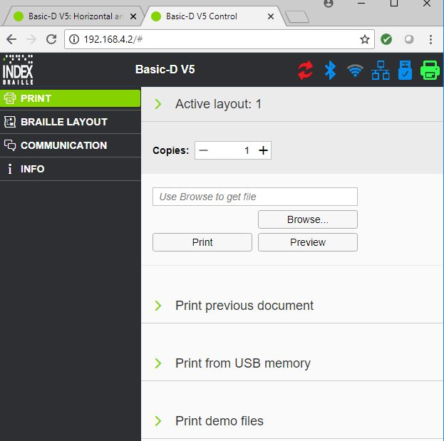
BrailleApp is the future
The BrailleApp is the next generation of interface to
Index V5 printers.
Support all common operation systems
Print braille without using a traditional braille editor
  Print in literary (G1) or contracted (G2) braille
  Preview the braille file in text or as braille-dots
  Edit the translated braille file
  Brows for source file
    docx, doc and pdf
    From your computer
    From the USB memory inserted on the printer
Monitor and control printer icons
  Firmware upgrade
  Bluetooth
  Wi-Fi
  Wired network
  USB memory inserted on the printer
  Embosser status

Slide 12

Welcome to our world
Braille printing made easy
www.indexbraille.com

