Slide 1
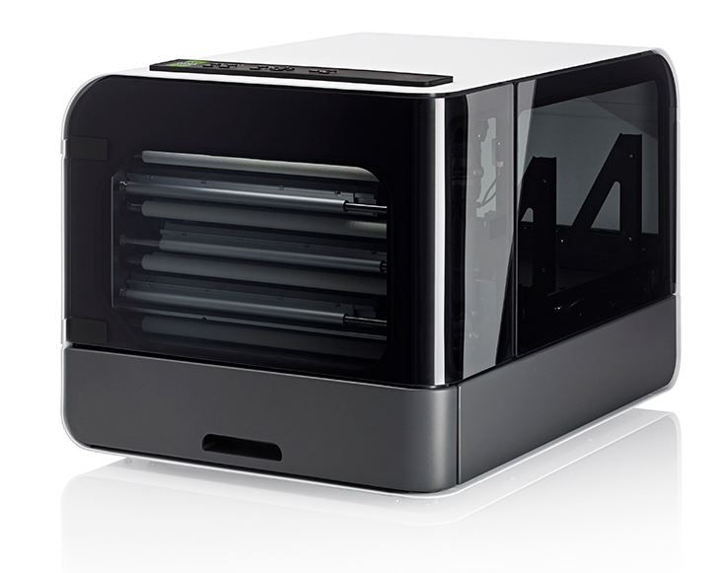
Everest-D V5 presentation
Braille printing made easy
www.indexbraille.com

Slide 2
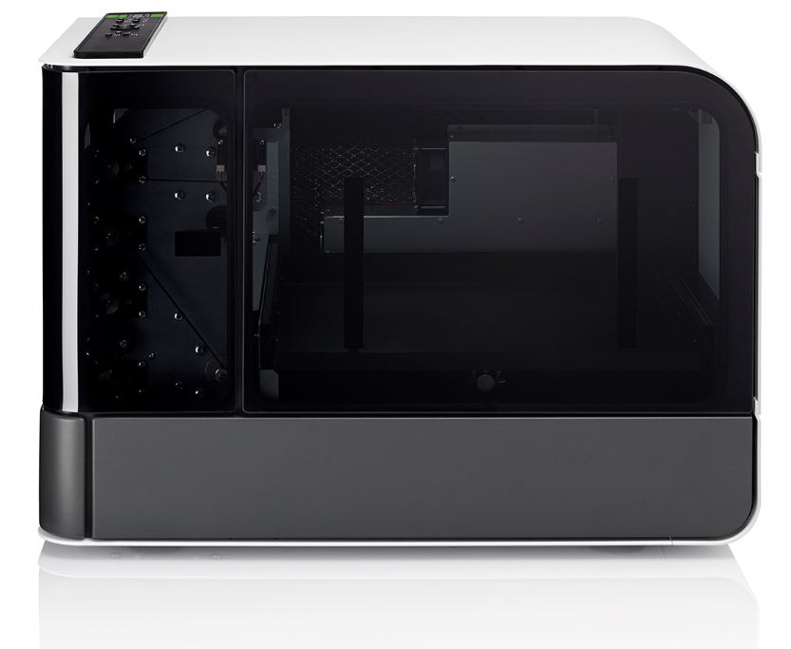
The idea of BrailleBox
Triple the speed of traditional embossers achieved by using 3 embossing heads
Price, a fraction of competitors
  Re-use Basic/Everest modules
  Benefit from higher total production volume
  Re-use of well established modules increases
  quality
Reduce the noise level by the closed construction
Increase the sheet-feeder size, the same
unit was used by HP in LaserJet 3.
Make glass and light as design objects
Dark active surfaces and light covers
Optimized for booklet printing on A3 or
11x17 inch paper

Slide 3

5 Design awards
BrailleBox is the most beautiful braille printer ever made. It is the only product for the blind with multiple design awards.
RedDot, Germany
Good Design, USA
Great Design Price, Sweden
German Design Award

Slide 4
BrailleBox V5 vs. V4
The BrailleBox V4 was the most advanced development work Index have ever completed. As such there was some improvement opportunities in the BrailleBox V4 which we have now significantly improved on in BrailleBox V5.
Complicated electronic hardware is simplified. Number of electronic boards is reduced from 4 to 2.
The mechanical door opening is replaced with opening by the DOOR key
Sensors for embossing head home position is implemented
All parts of the user interface is integrated in the control panel of BrailleBox V5.
The LED lights are simplified
The paper arms/servos can be replaced without open the top cover

Slide 5
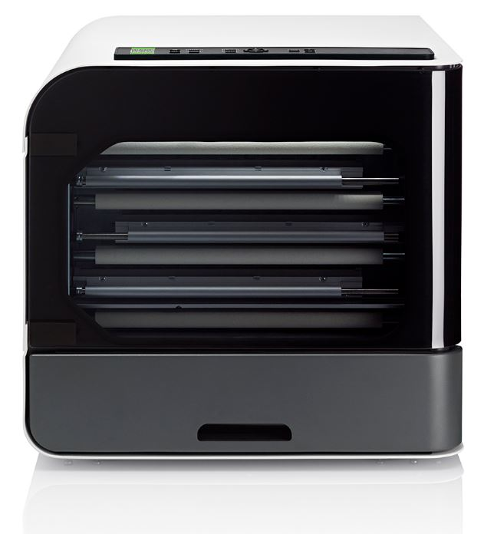
Most popular production braille printer
Since the introduction in 2011 the BrailleBox has dominated the global production braille printer market
High braille quality
300-pages sheet-feeder
Three embossing head giving high-speed
Competitive price
Braille and text labelled
control panel
Possible to mix braille and tactile-graphics
within the same document

Slide 6
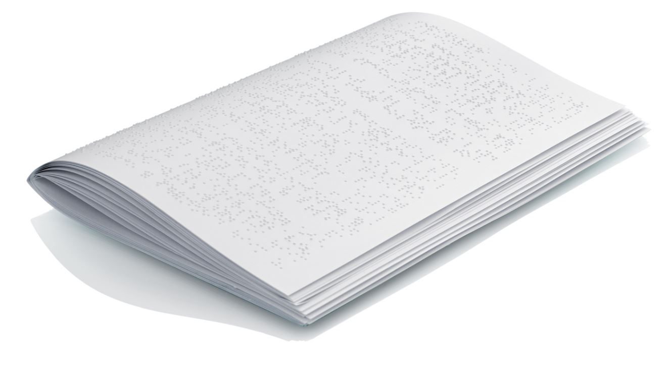
Booklet the recommended format
Booklet printing is made on A3 or 11,5x17 inch paper, it folds to A4 or letter format. Benefits with booklet:
The paper out works is reduced to staple and fold. No need for holing, wire binding etc.
The embossing speed is higher than on smaller A4/letter papers
The function of the sheet-feeder is even more stable with this wider paper
The booklet braille production process
  Print
  Staple
  Fold

Slide 7
BralleBox a fix star in braille production
BrailleBox is the market leading sheet-fed production
braille printer since the introduction in 2011.
BrailleBox is 100% constructed by Index
BrailleBox is made for continuous printing
BrailleBox sheet-feeder production tools and
intellectual property is owned by Index
The sheet feeder is tuned for best function on
heavy braille paper

Slide 8
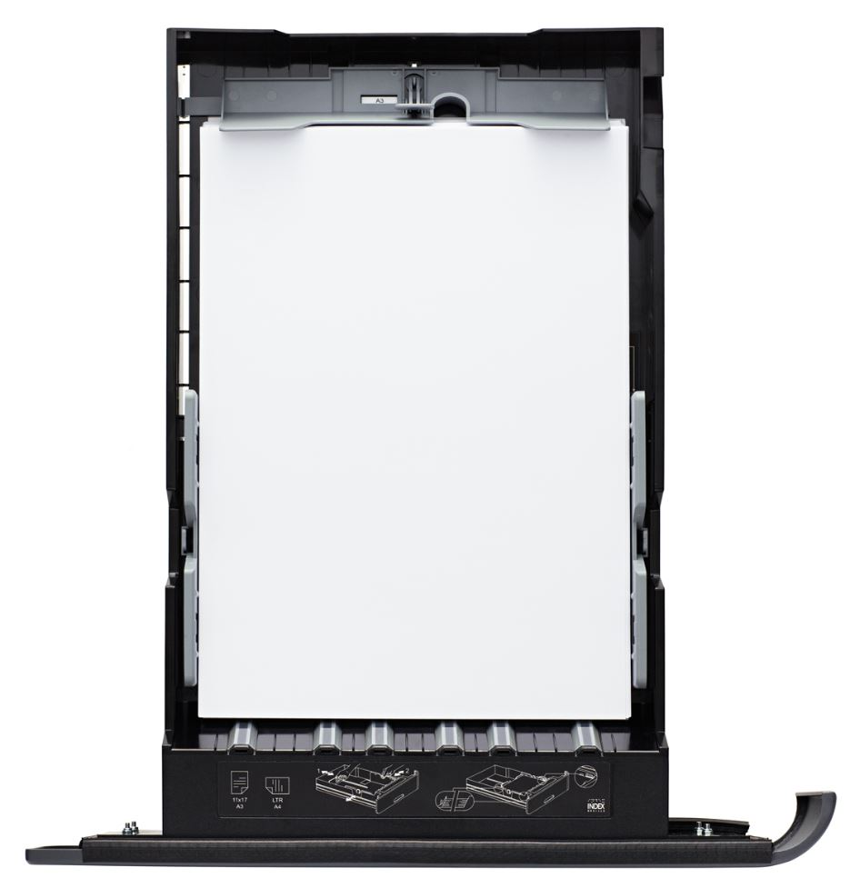
Useful cut-sheet feeder
Cut-sheet paper is available every ware
Cut-sheet paper is inexpensive
The 300-pages sheet-feeder owned by Index
Paper width up to 297 mm
Paper length up to 432 mm

Slide 9
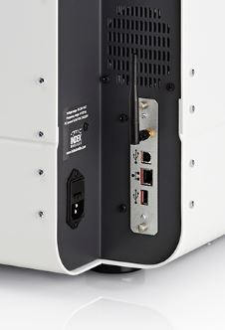
All connectors
Network
  Wired IP port
  WiFi IP port
Bluetooth
Standard USB port
USB Host port
Braille printing from
standard USB

Slide 10
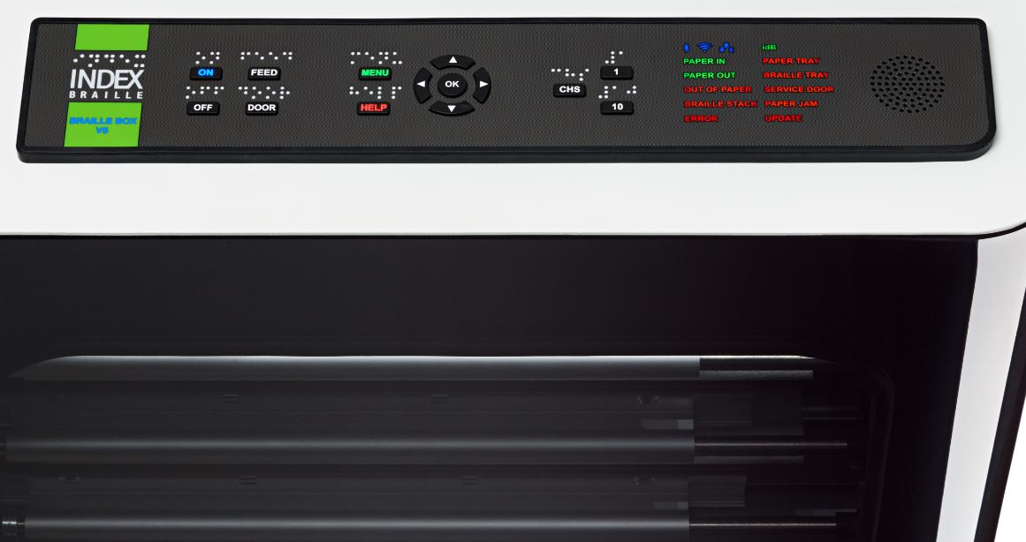
Modern user interface
Control panel
  Speech feedback in 19 languages
  Speaker embedded in control panel
  Labelled in braille and text
  LED lighted text and icon feedback

Slide 11
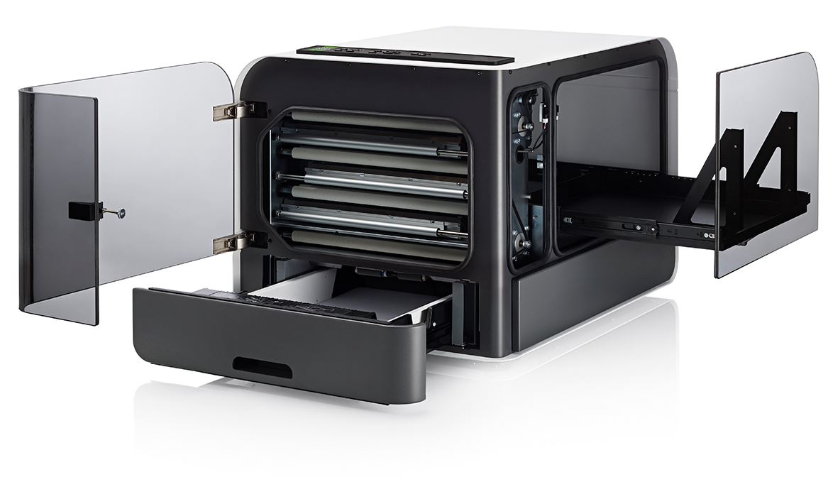
Easy to maintain
Front door access
  Embossing head
  Paper transportation
Braille door access
  Braille document
  Paper arms and servos
  Electronic driving board
Paper tray
  Insert new paper
  Adjust paper size
  Maintain pick-up roller

Slide 12
Useful features
No need for a separate braille editor
Support all operation systems
Supports booklet (vertical) printing
Index BrailleApp
USB Host port for printing from a USB memory
High resolution tactile graphics
Acapela speech guide the user
Remote support via Internet
Liblouis text-to-braille translation is included
  More than 150 languages
  Literary (G1) and contracted (G2) braille

Slide 13
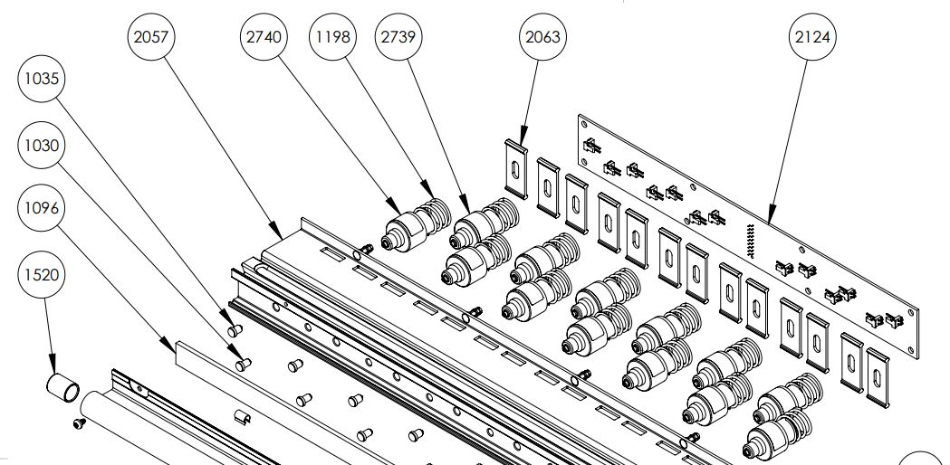
Build to last
Everest-D is 100% constructed by Index
The sheet-feeder tools and production rights are own by Index
The clean module design is the core for a competitive price with world leading quality.
Easy to maintain
  Replacement of modules is quick and
  require minimum training
  No mechanical adjustments
  Firmware upgrade is free,
  at www.indexbraille.com
Open information structure
  Spare parts web
  Exploded view document
  Knowledge base questions
  Spare parts available many years
  support@indexbraille.com to access support portal

Slide 14
High quality braille
Index braille is well known since decades for good braille quality. This is how we define high quality braille:
Round dot, following the surface of sphere
  With no holes
  With no cracks
Braille dot dimensions
  Height 0,5 mm
  Diameter of dot base 1,6 mm
  Diameter of the sphere 1,7 mm
Braille cell size
  Distance within the cell 2,5 mm
  Distance between the cells 3,5 mm
  Placed in a perfect grid

Slide 15
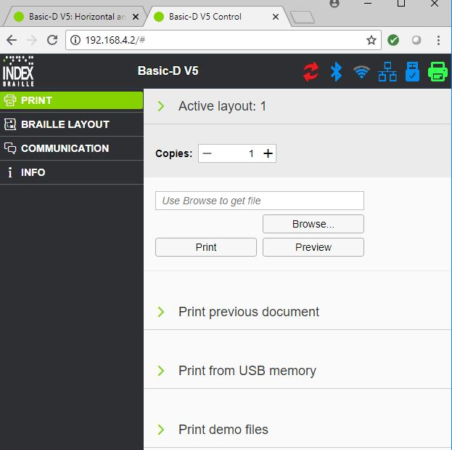
BrailleApp is the future
The BrailleApp is the next generation of interface to
Index V5 printers.
Support all common operation systems
Print braille without using a traditional braille editor
  Print in literary (G1) or contracted (G2) braille
  Preview the braille file in text or as braille-dots
  Edit the translated braille file
  Brows for source file
    docx, doc and pdf
    From your computer
    From the USB memory inserted on the printer
Monitor and control printer icons
  Firmware upgrade
  Bluetooth
  Wi-Fi
  Wired network
  USB memory inserted on the printer
  Embosser status

Slide 16

Welcome to our world
Braille printing made easy
www.indexbraille.com

